Slide 1
Primary Source Analysis
From the Instructions of Ptahhotep:
“How good is it for a son to take advice from his father; he will grow old through it.”
Analysis: What does this reveal about Egyptian social values and the importance of hierarchy?
Notes:
Hieroglyphic text with translation

Slide 2
Essential Questions Revisited
For Reflection:
How did geography create such a stable civilization?
What are the costs and benefits of divine kingship?
How do religious beliefs shape political and social systems?
How did Egyptian achievements influence later civilizations?# Egyptian Influence on Rome
Imperial Adaptations:
Augustus - adopted Egyptian royal imagery and propaganda techniques
Imperial cult - divine emperor concept influenced by pharaonic model
Obelisks in Rome - 13 Egyptian obelisks transported to decorate the capital
Architectural grandeur - monumental building scale inspired by Egyptian temples
Cleopatra’s legacy - last pharaoh’s relationships with Caesar and Antony# Egyptian Medical Knowledge
The Edwin Smith Papyrus (c. 1600 BCE): - 48 surgical cases - detailed descriptions of head and chest injuries - Rational diagnosis - “If you examine a man having a wound…” - Surgical procedures - suturing, splinting, and wound care - Anatomical terms - first known medical terminology
Knowledge from mummification - understanding internal organs— title: “Ancient Egypt: Gift of the Nile” subtitle: “Divine Kingship and Monumental Civilization” author: “Core Lesson - 75 Minutes” date: “” —
Notes:
Discussion slide
Images of Roman adoption of Egyptian elements
Image of Edwin Smith Papyrus

Slide 3
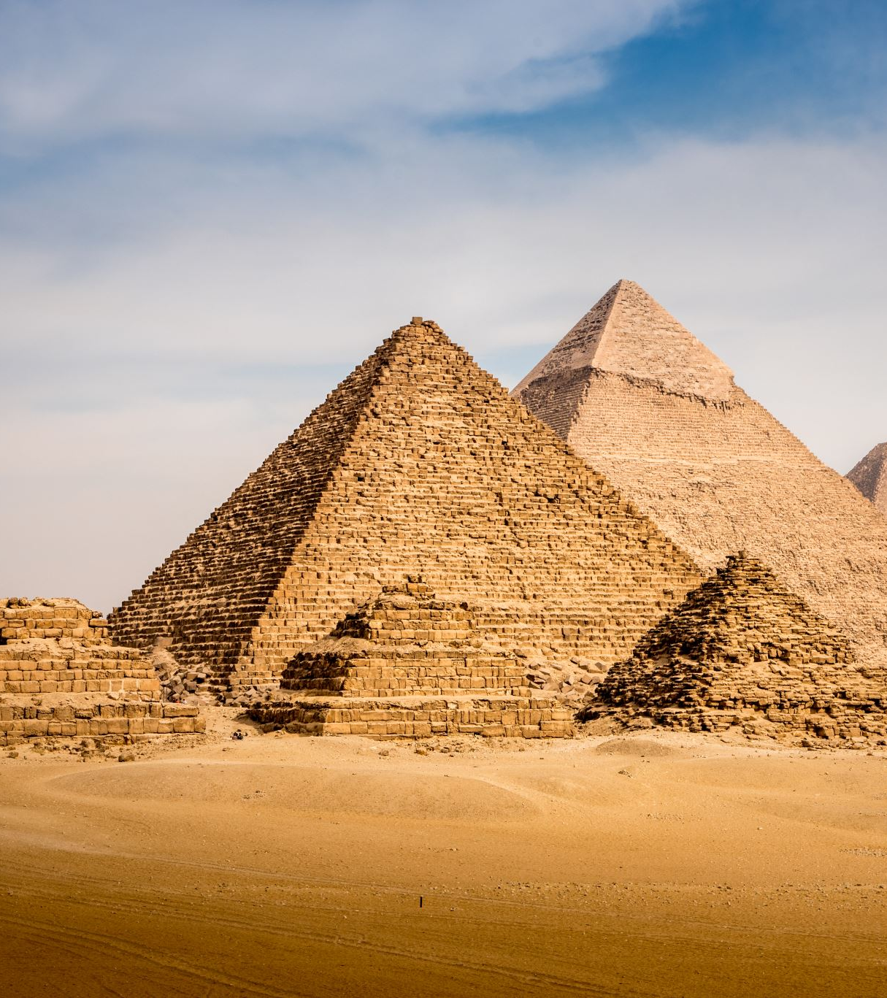
The Egyptian Paradox
Opening Question:
How did a civilization surrounded by some of the world’s harshest deserts become one of history’s most stable and long-lasting societies?
Notes:
Image suggestion: Split view of lush Nile valley surrounded by vast desert

Slide 4
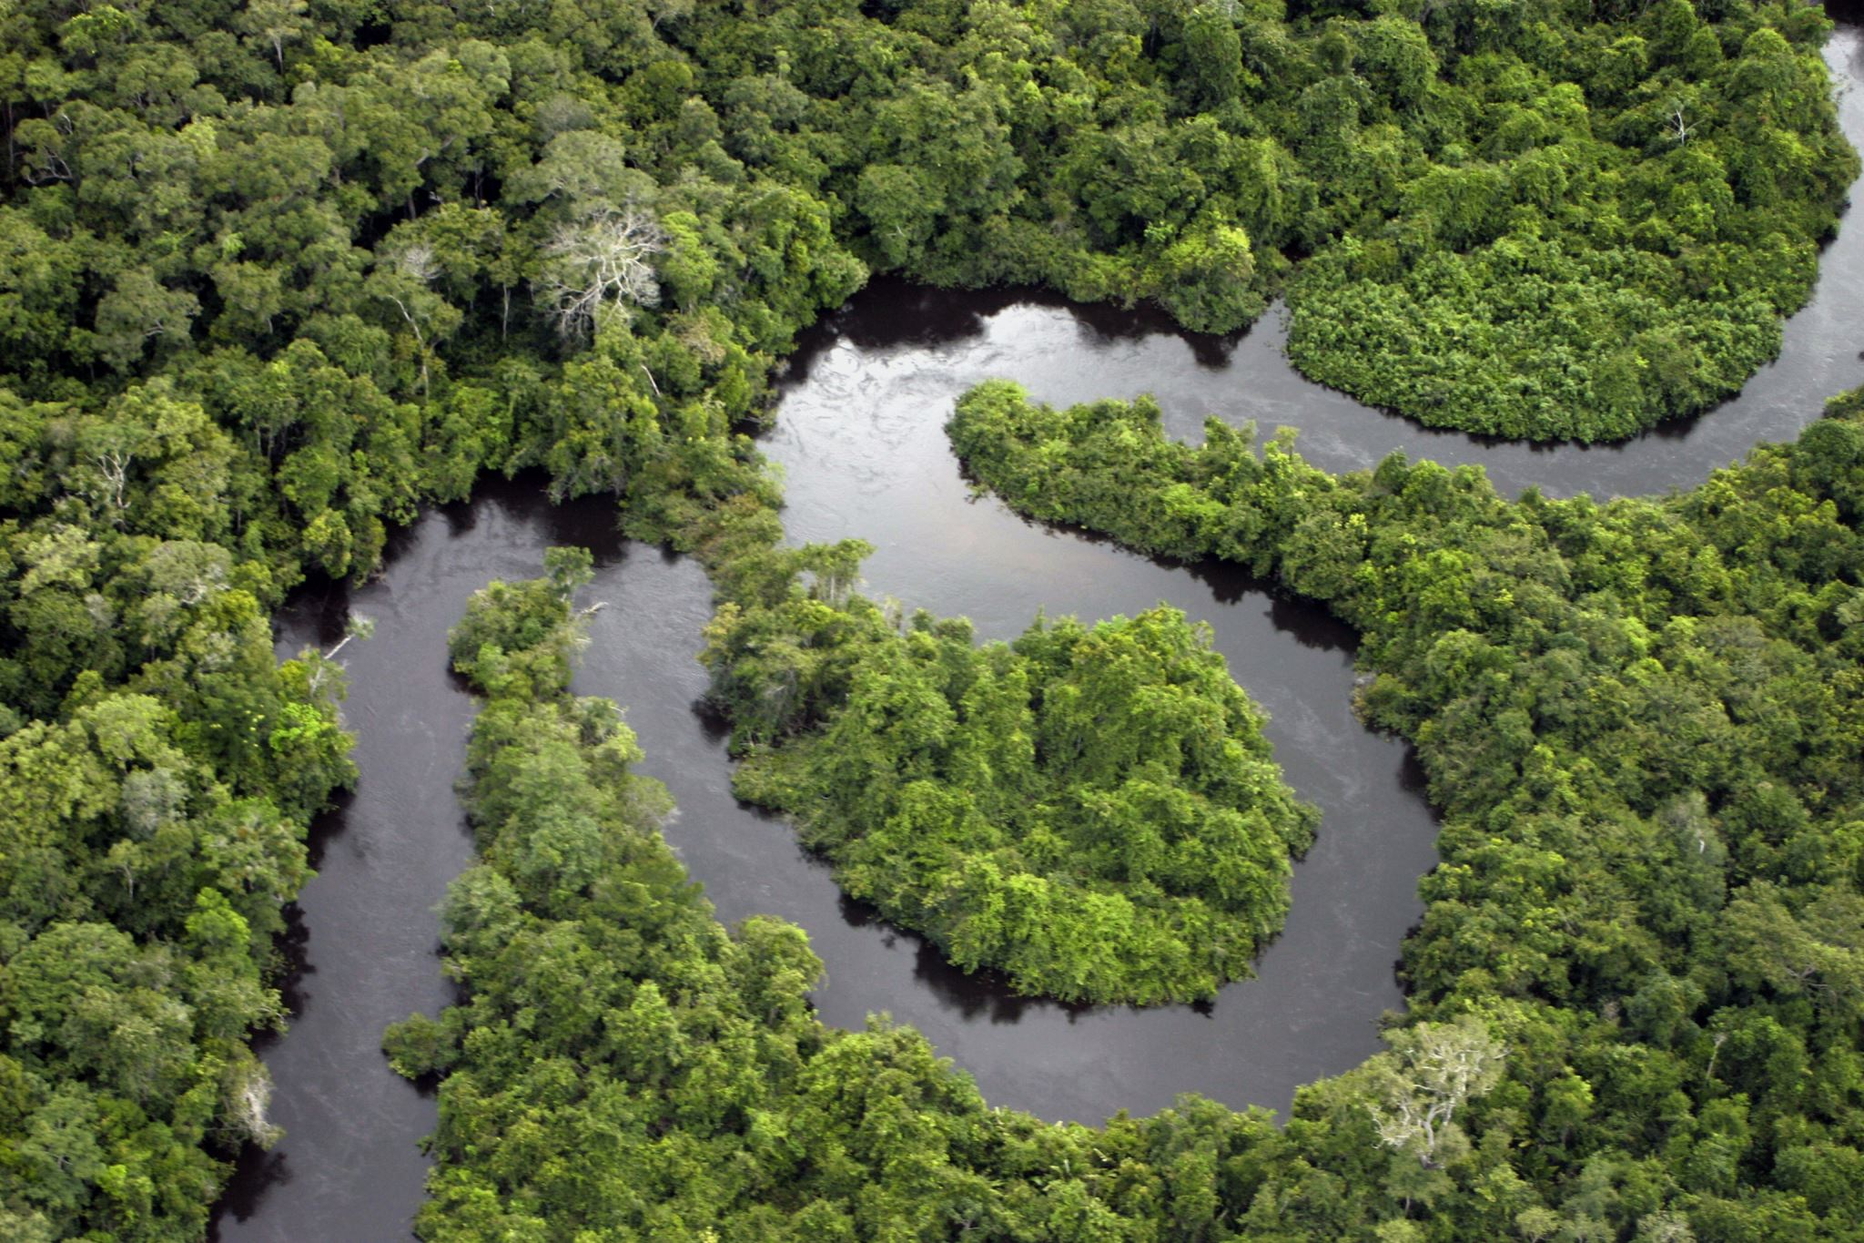
The Nile’s Gift
Nature’s Perfect Calendar:
Predictable annual flooding - June to October
Rich silt deposits - natural fertilizer
Three seasons: Flood, Growth, Harvest
Agricultural surplus - feeding large populations
Notes:
Image suggestion: Nile flood cycle diagram

Slide 5
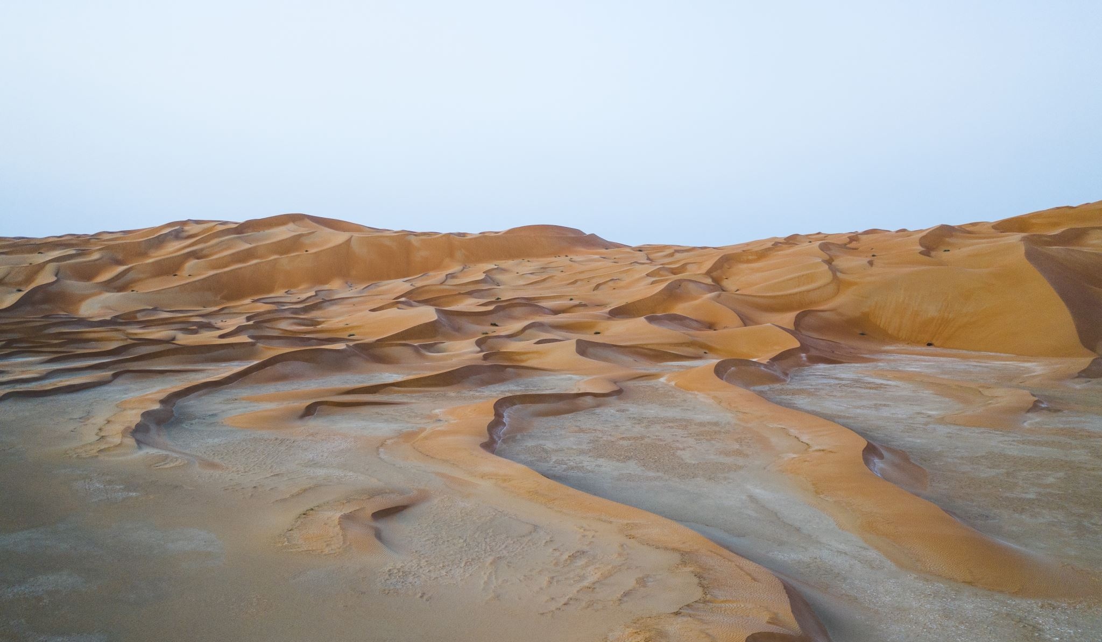
Geographic Protection
Natural Fortress:
Deserts to east and west
Cataracts (rapids) to the south
Mediterranean Sea to the north
Result: Cultural isolation and security
Notes:
Map showing Egypt’s natural barriers

Slide 6
The Geographic Question
For Consideration:
How might Egypt’s geographic security and predictable agriculture have shaped a completely different worldview from Mesopotamia’s constant uncertainty?
Notes:
Discussion slide

Slide 7
The Birth of Pharaonic Rule
Unification c. 3100 BCE:
Narmer/Menes unites Upper and Lower Egypt
Two Lands become one kingdom
Divine kingship concept emerges
3,000 years of continuous rule begins
Notes:
Image suggestion: Early pharaoh wearing both crowns

Slide 8
What Made Pharaohs Different?
Not Just Kings - Living Gods:
Divine nature - son of Ra, the sun god
Cosmic responsibility - maintaining universal order (Ma’at)
Absolute authority - word is divine law
Eternal rule - death is just transition
Notes:
Comparison of divine vs. mortal rulers

Slide 9
The Concept of Ma’at
Universal Order and Balance:
Truth, justice, and harmony
Pharaoh’s duty - maintaining Ma’at on earth
Social stability - everyone has their place
Cosmic balance - linking human and divine worlds
Notes:
Image showing Ma’at goddess with feather

Slide 10
Egyptian Social Hierarchy
Rigid but Stable Structure:
Top: Pharaoh (divine) High: Nobles, priests, high officials Middle: Scribes, craftsmen, merchants Base: Farmers (90% of population) Bottom: Slaves
Notes:
Pyramid diagram of Egyptian society

Slide 11
The Power of the Scribes
“He who writes is free from toil”
Literacy equals power - hieroglyphic writing complex
Administrative backbone - running the kingdom
Social mobility - one path to advancement
Record keepers - preserving knowledge and history
Notes:
Image of Egyptian scribe statue

Slide 12
Old Kingdom: The Pyramid Age
2686-2181 BCE - Classical Egypt:
Pyramid construction - Giza monuments
Strong central authority - pharaoh as absolute ruler
Economic prosperity - resources for massive projects
Limited external threats - focus on internal development
Notes:
Image suggestion: Giza pyramid complex

Slide 13
Old Kingdom Military Campaigns
Southern Expansion:
Nubian campaigns - securing gold mines and trade routes
First Cataract fortresses - establishing southern border
Tribute extraction - Nubian gold funding pyramid construction
Trade expeditions - to Punt (modern Somalia/Ethiopia)
Notes:
Map showing early Egyptian expansion

Slide 14
Why Build Pyramids?
Massive Investment Question:
Why would a society spend enormous resources on tombs when they could build cities, roads, or armies?
Consider: What does this tell us about Egyptian values and beliefs?
Notes:
Discussion slide about resource allocation

Slide 15
The Pyramid as Statement
More Than Tombs:
Divine power demonstration - pharaoh’s godlike abilities
Eternal presence - pharaoh continues to protect Egypt
Economic engine - employing thousands of workers
Technological showcase - engineering mastery
Notes:
Image showing pyramid’s geometric perfection

Slide 16
Egyptian Religious Worldview
Afterlife-Focused Beliefs:
Divine pharaoh - living god maintaining cosmic order
Positive afterlife - eternal life if properly prepared
Mummification - preserving body for next world
Ma’at - truth, justice, and universal balance
Notes:
Image suggestion: Egyptian gods and religious scenes

Slide 17
Middle Kingdom: Reunification
2055-1650 BCE - Classical Revival:
Reunited kingdom after First Intermediate Period
Expanded borders - Nubia and Palestine
Cultural flowering - literature and art
Democratized afterlife - not just for pharaohs
Notes:
Image suggesting political stability and expansion

Slide 18
Middle Kingdom Conquests
Systematic Expansion:
Nubian conquest - Sesostris III’s campaigns to Second Cataract
Fortress system - 13 massive fortresses controlling Nile trade
Palestinian raids - Sesostris III reaches Shechem
Levantine influence - Egyptian control of trade routes to Asia
Notes:
Map showing Middle Kingdom territorial expansion

Slide 19
New Kingdom: Imperial Egypt
1550-1077 BCE - Empire Period:
Military revolution - horse-drawn chariots and bronze weapons
Greatest territorial extent - from Nubia to Euphrates River
Professional army - standing military with foreign mercenaries
Tribute and trade - wealth from vassal states
Notes:
Image suggestion: Egyptian military scenes and empire map

Slide 20
New Kingdom Military Campaigns
Thutmose III’s Conquests (c. 1479-1425 BCE):
Battle of Megiddo (1457 BCE) - decisive victory over Canaanite coalition
17 campaigns in Palestine and Syria
Euphrates frontier - Egyptian empire reaches its maximum extent
Tribute system - annual payments from conquered territories
Notes:
Map showing maximum Egyptian expansion

Slide 21
Ramesses II’s Wars
The Great Warrior Pharaoh (1279-1213 BCE):
Battle of Kadesh (1274 BCE) - massive chariot battle against Hittites
World’s first peace treaty (1259 BCE) - with Hittite Empire
Nubian campaigns - securing southern gold mines
Libyan threats - defending western borders against Sea Peoples
Notes:
Image of Ramesses II battle scenes

Slide 22
Famous New Kingdom Pharaohs
Remarkable Rulers:
Hatshepsut - female pharaoh, great builder
Akhenaten - religious revolutionary
Tutankhamun - boy king, restored traditions
Ramesses II - great conqueror and builder
Notes:
Images of Hatshepsut, Akhenaten, Tutankhamun, Ramesses II

Slide 23
Akhenaten’s Revolution
Religious Radical:
Monotheism - worship only Aten (sun disk)
New capital - Amarna, away from old priests
Artistic revolution - realistic, intimate style
Complete failure - reversed after his death
Notes:
Image of Akhenaten and Amarna art style

Slide 24
Why Akhenaten Failed
Revolutionary vs. Traditional:
Too radical - disrupted 1,500 years of tradition
Threatened priests - lost essential political support
Ignored foreign threats - empire weakened
Contradicted Ma’at - Egyptians valued stability over change
Notes:
Discussion slide

Slide 25
Egyptian Women
Relatively High Status:
Legal rights - own property, conduct business
Religious roles - priestesses and temple musicians
Political influence - some ruled as pharaohs
Economic participation - weaving, brewing, trading
Notes:
Image showing Egyptian women in various roles

Slide 26
The Hieroglyphic System
Complex Writing System:
Three types: Pictographic, syllabic, alphabetic
Sacred writing - “words of the gods”
Formal and cursive - hieroglyphs and hieratic script
Decipherment - Rosetta Stone breakthrough
Notes:
Image showing different types of hieroglyphic signs

Slide 27
Egyptian Trade Networks
Commercial Connections:
Nubia - gold and exotic goods
Palestine/Syria - cedar wood and luxury items
Punt - incense, ebony, and ivory
Mediterranean - exchange with other civilizations
Notes:
Map showing Egyptian trade routes

Slide 28
The Decline of Egyptian Power
Gradual Weakening:
Sea Peoples invasions (1200-1150 BCE) - mysterious raiders disrupt Mediterranean
Libyan invasions - pressure on western borders
Internal divisions - weak pharaohs and powerful priests
Economic decline - loss of tribute from former empire
Notes:
Timeline showing foreign invasions and internal problems

Slide 29
Foreign Conquests of Egypt
End of Independence:
Assyrian conquest (671-663 BCE) - Esarhaddon and Ashurbanipal
Persian rule (525-332 BCE) - Cambyses makes Egypt a Persian province
Alexander’s conquest (332 BCE) - welcomed as liberator from Persians
Roman annexation (30 BCE) - Octavian defeats Cleopatra VII
Notes:
Map showing successive foreign rulers

Slide 30
Cleopatra: The Last Pharaoh
Greek Pharaoh:
Ptolemaic dynasty - Greek rulers of Egypt
Cultural synthesis - Hellenistic and Egyptian
Political alliance - with Julius Caesar and Mark Antony
Roman conquest - 30 BCE, end of independence
Notes:
Image of Cleopatra and Ptolemaic period

Slide 31
Egyptian Influence on Greece
Direct Cultural Transmission:
Greek philosophers - Thales, Pythagoras, and Plato studied in Egypt
Mathematical knowledge - geometry and astronomical calculations
Medical practices - surgical techniques and diagnostic methods
Architectural elements - columns and monumental building techniques
Herodotus: “Egypt is the gift of the Nile” - Greeks recognized Egyptian achievements
Notes:
Images showing Greek-Egyptian connections

Slide 32
Egyptian Legacy in Modern World
Continuing Influence:
Architectural elements - obelisks in major cities
Medical knowledge - surgical and diagnostic techniques
Mathematical concepts - geometric principles
Cultural symbols - pyramid, sphinx, ankh
Notes:
Examples of Egyptian influence today

Slide 33
Essential Questions Revisited
For Reflection:
How did geography create such a stable civilization?
What are the costs and benefits of divine kingship?
How do religious beliefs shape political and social systems?
What can we learn from Egypt about the relationship between stability and innovation?
Notes:
Discussion slide

Slide 34
Egypt’s Contribution to Western Civilization
Foundational Elements:
Administrative systems - bureaucratic organization
Monumental architecture - inspiring later builders
Medical knowledge - scientific observation
Mathematical concepts - practical applications
Notes:
Flow chart showing Egyptian influences

Slide 35
Connections to Our Course
Looking Forward:
How did Greek thinkers respond to Egyptian wisdom traditions?
How did Roman emperors adapt pharaonic concepts of divine rule?
How did Christianity incorporate Egyptian afterlife beliefs?
Notes:
Bridge to Greece and Rome

Slide 36
Your Reflection Task
Analysis Question:
How did Egyptian concepts of divine kingship and monumental architecture influence both Greek philosophical thinking and Roman imperial practices?
Use specific examples from Egyptian achievements to support your analysis.
Notes:
Assignment prompt

Slide 37
Next Time
Coming Up: Ancient Greece
How did a collection of small, often warring city-states create innovations in government, philosophy, and culture that still influence us today?
Notes:
Preview of Greek lesson

